Slide 1
System
Miami
By: Evethalie StLouis and Layla Hoey

Slide 2
01
Overview

Slide 3
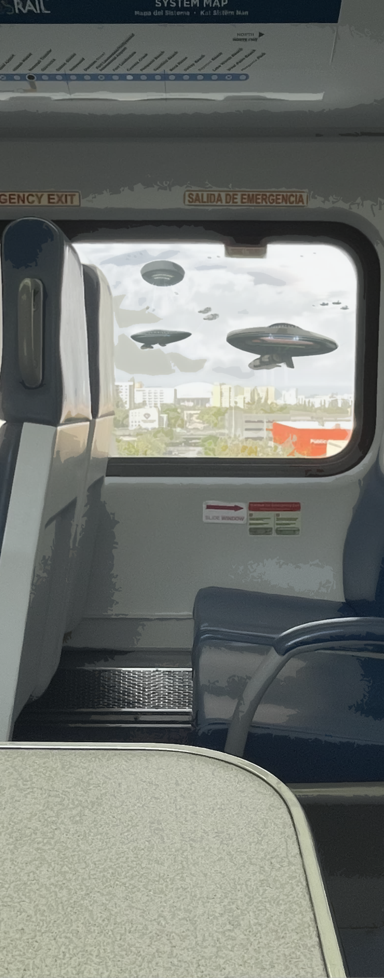
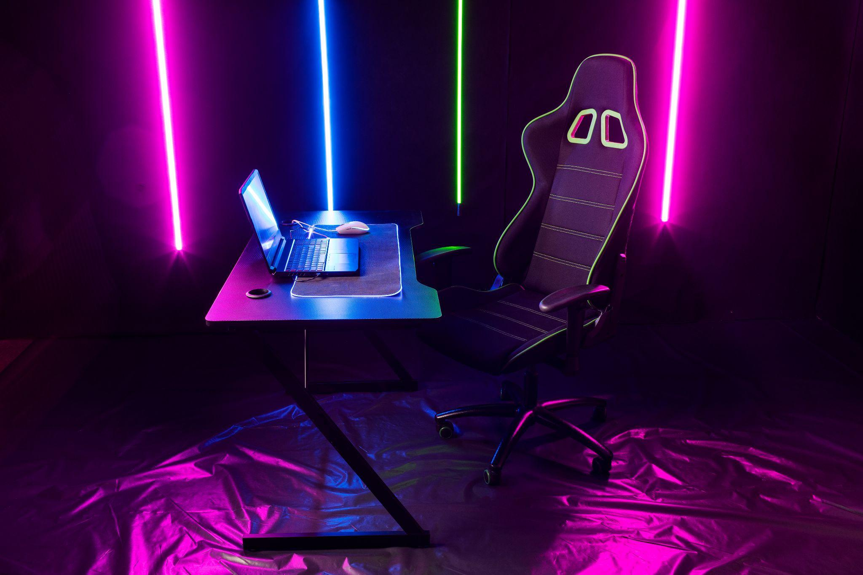
[System Miami] is a 2.5D RPG meets roguelike. The player gets the stats, story and adventure of an RPG with roguelike systems and mechanics.
The player wakes up to find that aliens have imposed a video game system on all of Earth.
Tutorial - After an unsuccessful encounter with a giant alien spider who has taken their little sister captive, our protagonist is rescued by a kind stranger.
Two years later they wake from a coma to find that humanity has integrated into The System.
In this post-apocalyptic world, the Player’s main objective is to survive combat encounters while searching Miami to find their little sister.
“The Cull” - The System is issuing a warning that all humans below a certain Experience Level by the end of the week will be “culled.” The others will transported to the Andromeda Utopia with their families.
In the end, the player finds their family and is able to get the transport, but not all is as it seems.

Slide 4
02
Objectives

Slide 5
The game is won by getting to level 10, reaching the last Area, and defeating the final Boss
Although there is no way to lose the overall game, death in a combat encounter means you must start over at the beginning of the Area with your progress reset, allowing player to try many different avenues and ideas
Core loop
Enter Area ->
Complete Combat Encounters ->
Level up/getting stronger ->
Reach XP Threshold ->
Next Area (harder combat)
Notes:
Bigger text

Slide 6
03
Mechanics

Slide 7
Choose Easy, Medium, Hard encounters to level up
Class system that determines player stats and special abilities
Various skills and powers player can obtain or purchase
Turn-based combat
Player has a movement phase and an Action phase where they can Use an Item, Use an ability or Use a basic attack

Slide 8
04
Audience & Platform

Slide 9
Our audience is both the RPG and the roguelike community, for people who like:
The grinding and measurable progress of rpgs, with emphasis on players’ ability to sculpt their experience.
The difficulty and satisfaction of finally beating a hard level in roguelikes.
We seek to create a simple but immersive game world that speaks to the hearts of these types of gamers.

Slide 10
Thank You

